Slide 1
Network Traffic Analyzer
Network Gurus
Anvar Suleyman
Ridvan Suleymanov

Slide 2
Team and Responsibility
Anvar Suleyman – design, implementation, as well as testing.
Ridvan Suleymanov - design, implemention and contributed to testing.

Slide 3
Introduction
Overview
This program is designed to process PCAP (Packet Capture) files, which are used to store network traffic data, to carefully examine network traffic. The program makes use of Scapy, a Python library for packet manipulation. It reads PCAP files, then extracts relevant data like IP addresses, protocols, and timestamps, and can analyze or visualize that data.

Slide 4
Introduction
Objectives
The Network Traffic Analyzer decodes and inspects every packet to get important data, including protocol specifics, port numbers, source and destination IP addresses, etc.
By analyzing the traffic patterns and detecting suspicious activities or irregularities (such as massive data transfers), the program assists in detecting possible network security breaches or attacks. The program analyzes traffic volume and flow patterns to identify defects or slowdowns in network traffic processing.

Slide 5
Introduction
Scope
The program is usable with a variety of network monitoring and analysis software packages since it uses Scapy's rdpcap(read pcap files) function to read PCAP files.
With a focus on key metrics like IP addresses, protocol kinds, and packet sizes, it collects and arranges data from packets.
The program visualizes the data in a variety of ways using libraries such as Matplotlib (visualization for Python). It shows time-series plots, histograms that classify protocols, and more. The examined data is made more understandable and useful by using these visuals.

Slide 6
Motivation, and problem formulation
Motivation
Real-time, effective network traffic monitoring is becoming more and more necessary in response to complex computer networks and an increase in cyberattacks. To keep optimal levels of service, it is important to rapidly identify performance concerns in more complex network systems.
Problem
It is becoming difficult to set up efficient network monitoring solutions since many of the current technologies are either too complicated or too costly. Efficiently examining a lot of network data from PCAP files requires a simple and affordable solution, especially in emergencies where quick action is essential.

Slide 7
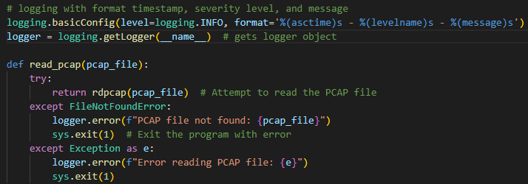
Method – Function read_pcap
Scapy is used by the Python read_pcap function to read network packets from a PCAP file, faults are handled by way of special exceptions. Error management and clear logging for troubleshooting are ensured by the fact that it logs errors related to file non-existence or other reading problems and stops the program if such errors occur.

Slide 8
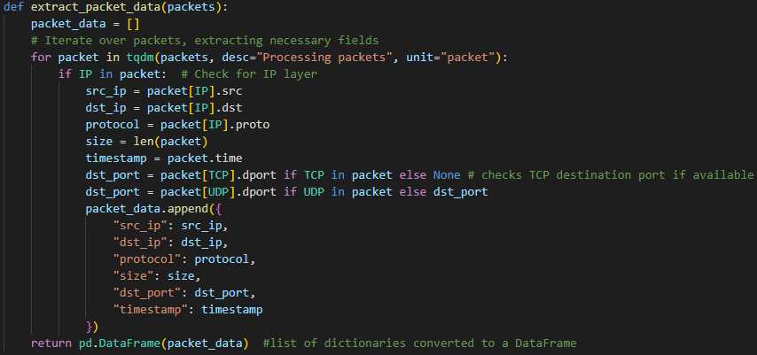
Method – Function extract_packet_data
A pandas DataFrame is created by repeatedly going over a list of network packets and extracting important information such as IP addresses, protocols, and sizes. Tqdm(progress bar) for progress tracking in organized data collecting. Making the function effective for handling massive amounts of network data.

Slide 9
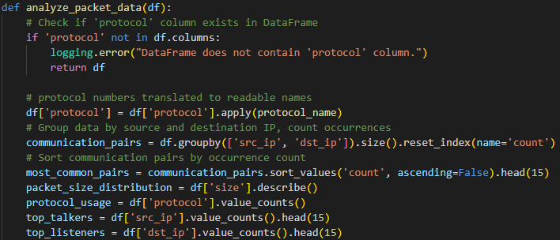
Method – Function anaylze_packet_data
Detailed statistical analysis of network packet data that is carried out by the analyze_packet_data function, which also determines the most popular communication pairings, protocol usage, and significant network talkers and listeners. It detects and measures data to offer understanding of network traffic patterns.

Slide 10
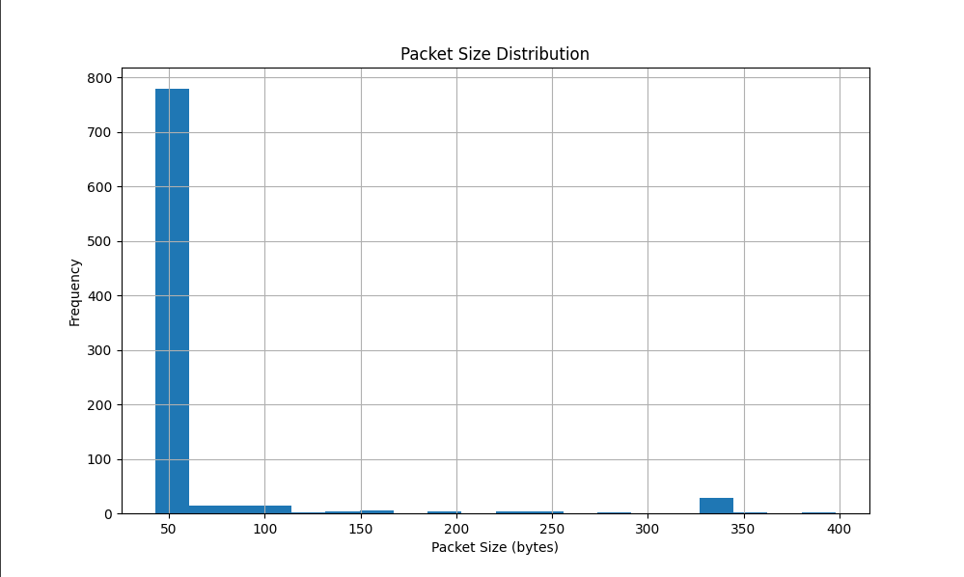
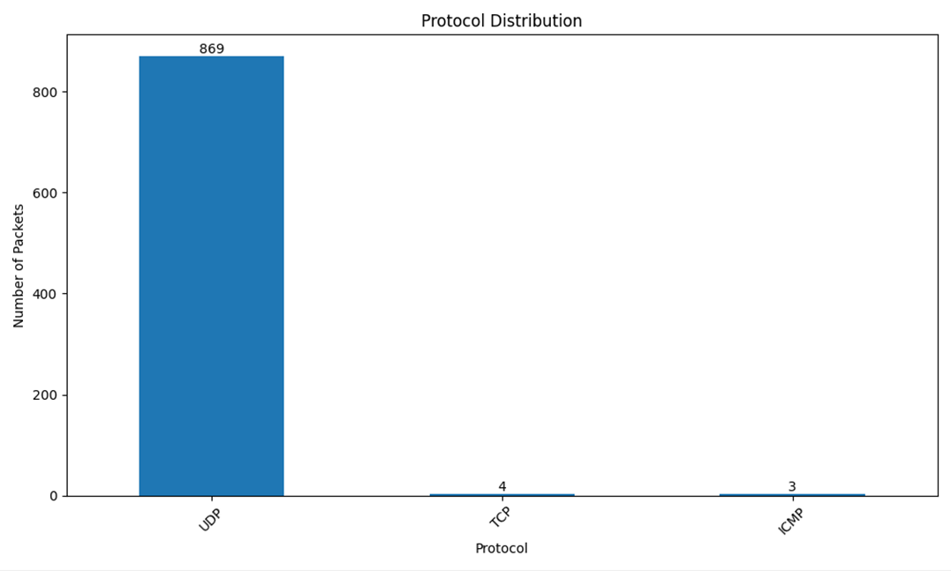
Result – Visual Representation
Packet Size Distribution Graph
An overview of the range and frequency of packet sizes throughout the network is given by the packet size distribution graph, which also highlights any common or outlier sizes that can indicate odd usage trends. Normally packet sizes have mixed-frequency distribution among different packet sizes.
This sample capture consisted of IPv6 traffic, with a focus on UDP protocol, with the addition of a unique call server IP for traffic decoding.
Protocol Distribution
The graph shows that UDP(User Datagram Protocol) packets are way more than TCP and ICMP packets. This can lead to a UDP flood assault, a kind of Denial-of-Service (DoS) attack. Usually, a UDP flood attack uses up all the memory and CPU resources in addition to the network bandwidth, blocking the flow of actual traffic.

Slide 11
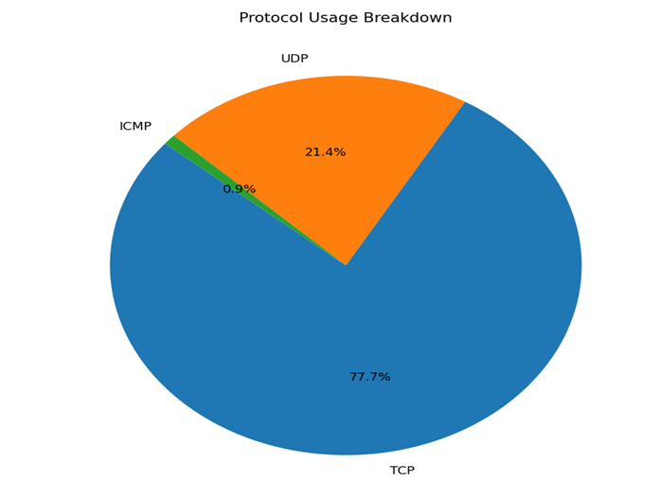
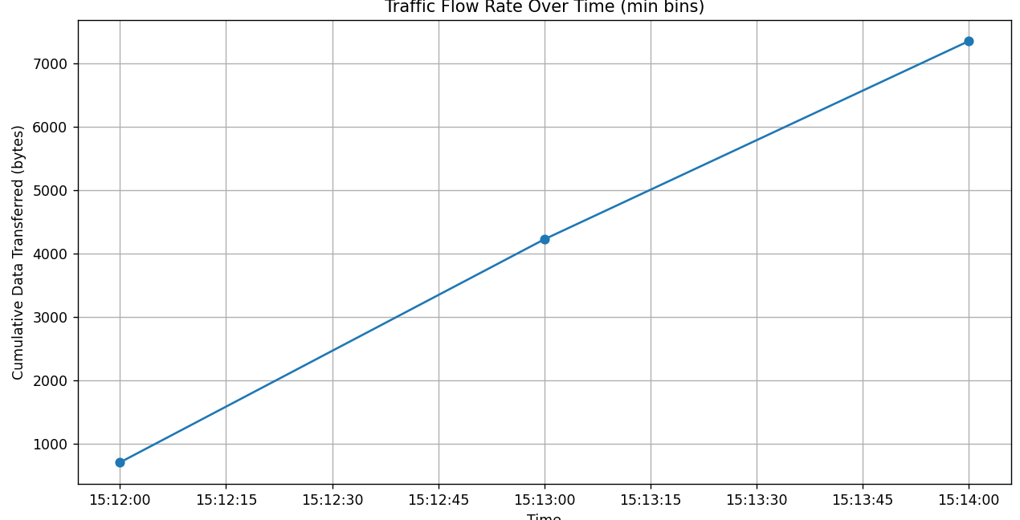
Results – Visual Representation
Protocol Usage Breakdown
The TCP traffic leads indicate it’s used for key applications where consistent data delivery is a must. UDP’s present as well, pointing to some applications that need quick data exchange, like live streams or online games. The low ICMP traffic is a good sign, likely meaning the network's stable or they are actively stopping certain cyber threats, such as ping floods.
Traffic Flow Rate Over Time Chart
The graph shows network traffic consistently going up over a short period, measured by the minute. It shows a network that’s constantly at work, with no big downtime or unexpected traffic jumps that might mean bursts of activity. This pattern could reflect ongoing data processes or sustained user activity. The linear progression shows a stable network environment with predictable bandwidth requirements.

Slide 12
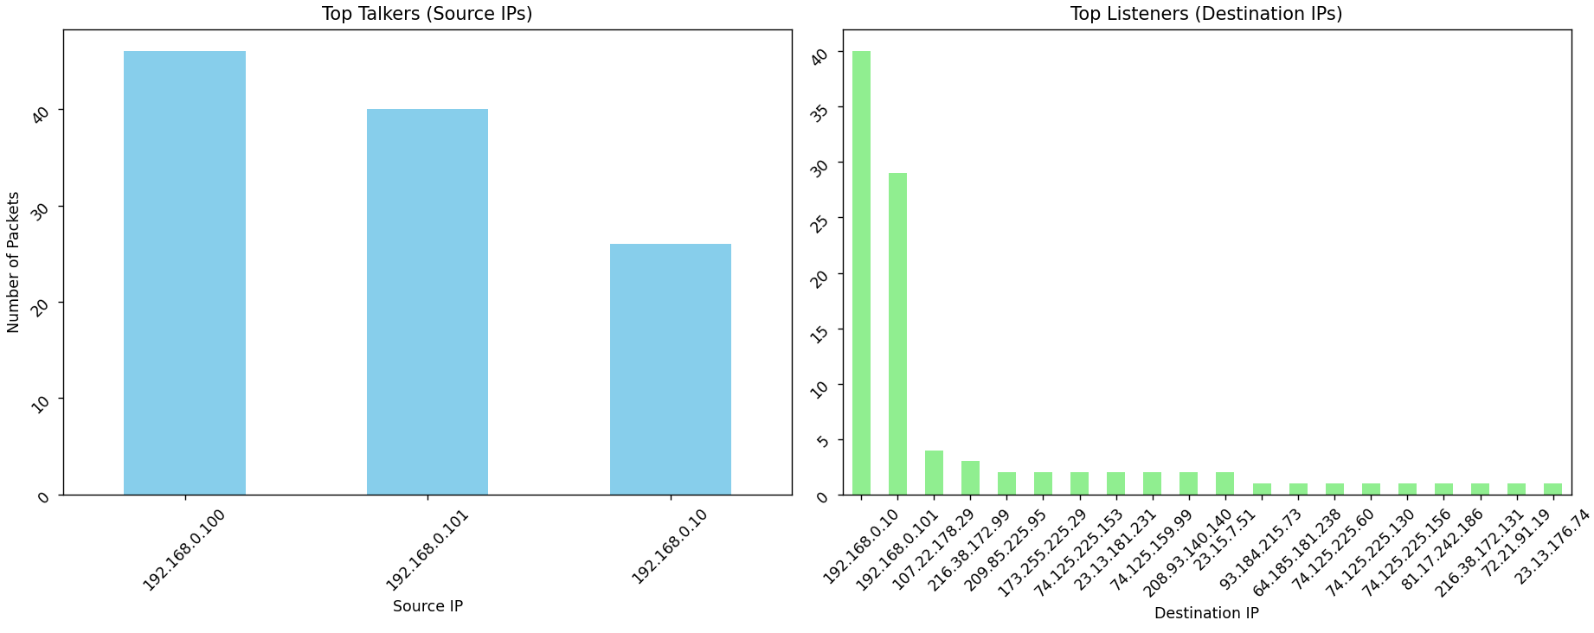
Results - Visual Representation
Top Talkers and Listeners
The 'Top Talkers' chart identifies 192.168.0.100 as the key source IP, which is probably a main server or hub because it sends out the most packets. Also. IP addresses 192.168.0.101 and 192.168.0.10 are quite active, showing that they might be clients or secondary servers.
The 'Top Listeners' chart shows 192.168.0.10 receiving the most packets, indicating it plays a major part in the network. The spread of other destination IPs with fewer packets points to a mix of direct client-server and peer-to-peer communications.

Slide 13
References
https://scapy.net/
https://matplotlib.org/
https://www.bookey.app/book/computer-networks
https://wiki.wireshark.org/SampleCaptures

